Slide 1
Campuswire browser extension
--Developer team

Slide 2
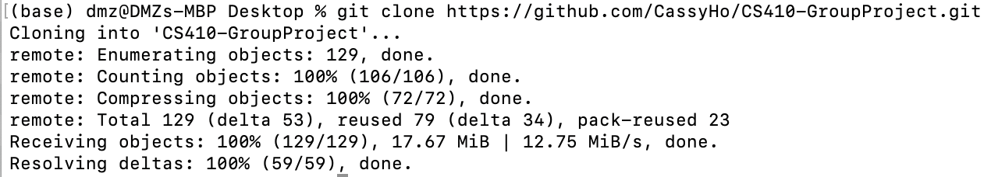
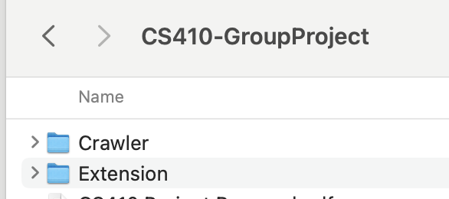
HOW TO INSTALL
Download Source Code

Slide 3
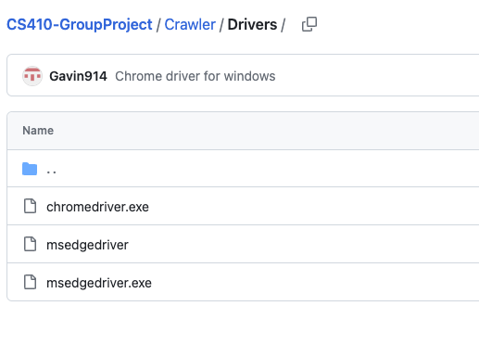
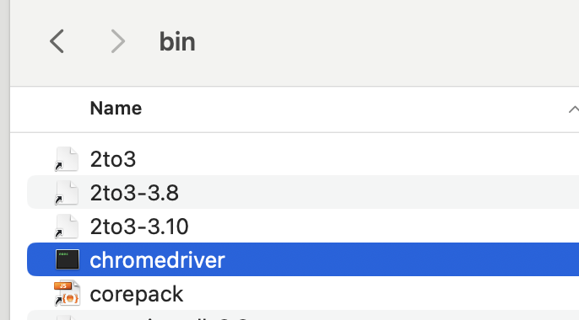
HOW TO INSTALL
2a. Driver for Edge(Windows, Mac), Chrome(Windows)
2b. Driver for Chrome(Mac): https://chromedriver.chromium.org/downloads
Download the driver and put it in this folder on your PC if you are using macOS: /usr/local/bin

Slide 4

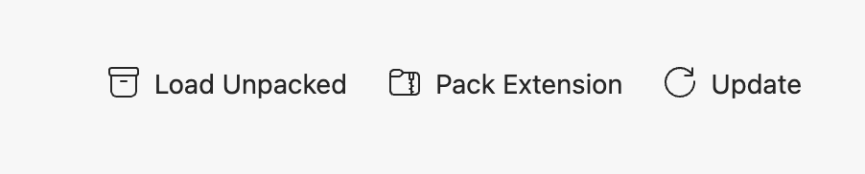
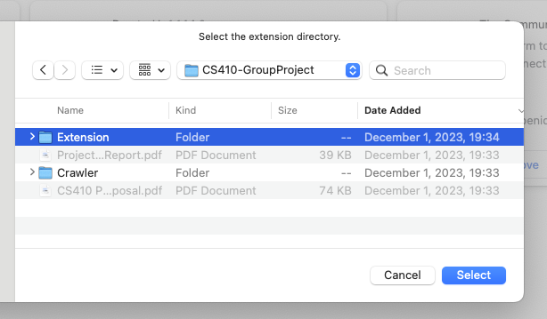
HOW TO INSTALL
3. Install Extension
Go to Extensions -> Manage Extensions
Turn on developer mode
Hit Load unpacked -> Navigate to the Extension folder and hit “Select”

Slide 5
HOW TO INSTALL
4. Install Python packages
Python version: 3.11.4
selenium: 4.9.0
nltk: 3.8.1
flask: 2.2.2
If you encountered any error that ask you to install any missing packages, please follow the prompt to install

Slide 6
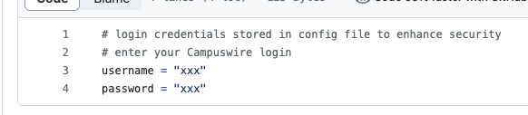
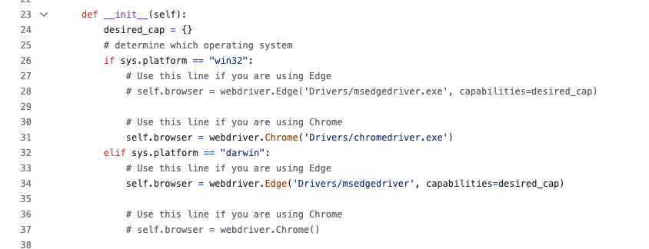
HOW TO INSTALL
5. Configure the code
Modify password and username to be your account in the config.py file in Crawler folder
Modify driver option in crawler.py file in Crawler folder.

Slide 7
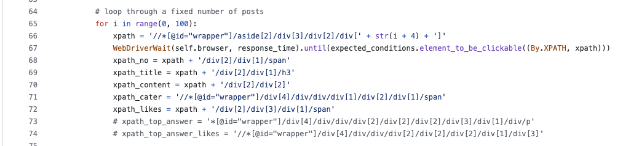
HOW TO INSTALL
(Optional) In the crawler.py file in Crawler folder, you can also change the number of most recent posts you’d like to scrape. The default is 100.

